Slide 1
Food Concepts Training Report
Comprehensive Training Analytics
Generated: October 26, 2025

Slide 2
Executive Summary
Report Year: 2025
📊 Total Trainings: 939
👥 Total Staff: 6809
✅ Staff Trained: 723
🏪 Stores Trained: 280
⏰ Pending Trainings: 5826

Slide 3
Training Frequency
Training Title | Times Held | Date Range
Food Safety | 279 | 2025-02-13 to 2025-09-30
Occupational Health & safety | 142 | 2025-02-05 to 2025-09-26
FIRST AID | 125 | 2025-02-04 to 2025-09-25
Fires Safety | 108 | 2025-01-30 to 2025-09-09
Water Treatment | 98 | 2025-03-25 to 2025-04-29
PEST CONTROL | 93 | 2025-02-18 to 2025-09-12
Occupational Health & Safety | 69 | 2025-09-03 to 2025-09-05
Food Handlers Workshop | 11 | 2025-03-21 to 2025-03-21
Frozen Pie Handling and Baking Process | 9 | 2025-06-16 to 2025-06-16
Energy conservation | 3 | 2025-06-16 to 2025-06-16
Preventive Maintenance Workshop | 1 | 2025-06-16 to 2025-06-16
Effective Restaurant Management Workshop | 1 | 2025-06-16 to 2025-06-16

Slide 4
Stores Training Coverage
Total Stores: 577
✅ Stores Trained: 280 (48.5%)
⏳ Stores Pending: 297 (51.5%)

Slide 5
Staff Participation Analysis
Total Eligible Staff: 6215
Participated: 723 (11.6%
Not Participated: 5492
Participation Rate 11.6%

Slide 6
Food Safety Compliance
Food Handlers / Food Safety Training Status
Required to be Tested: 6215
Already Tested: 285 (4.6%)
Never Tested: 5930
Due for Testing: 5930

Slide 7
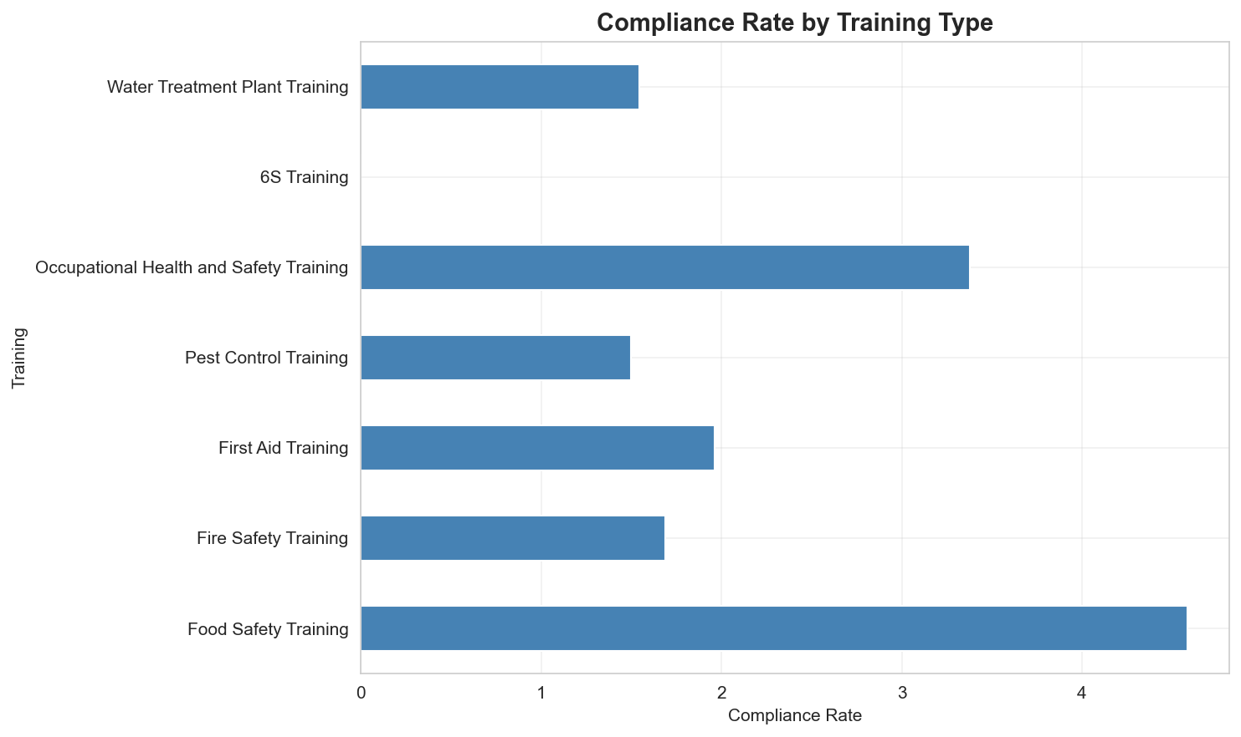
Compliance Dashboard - All Required Trainings

Slide 8
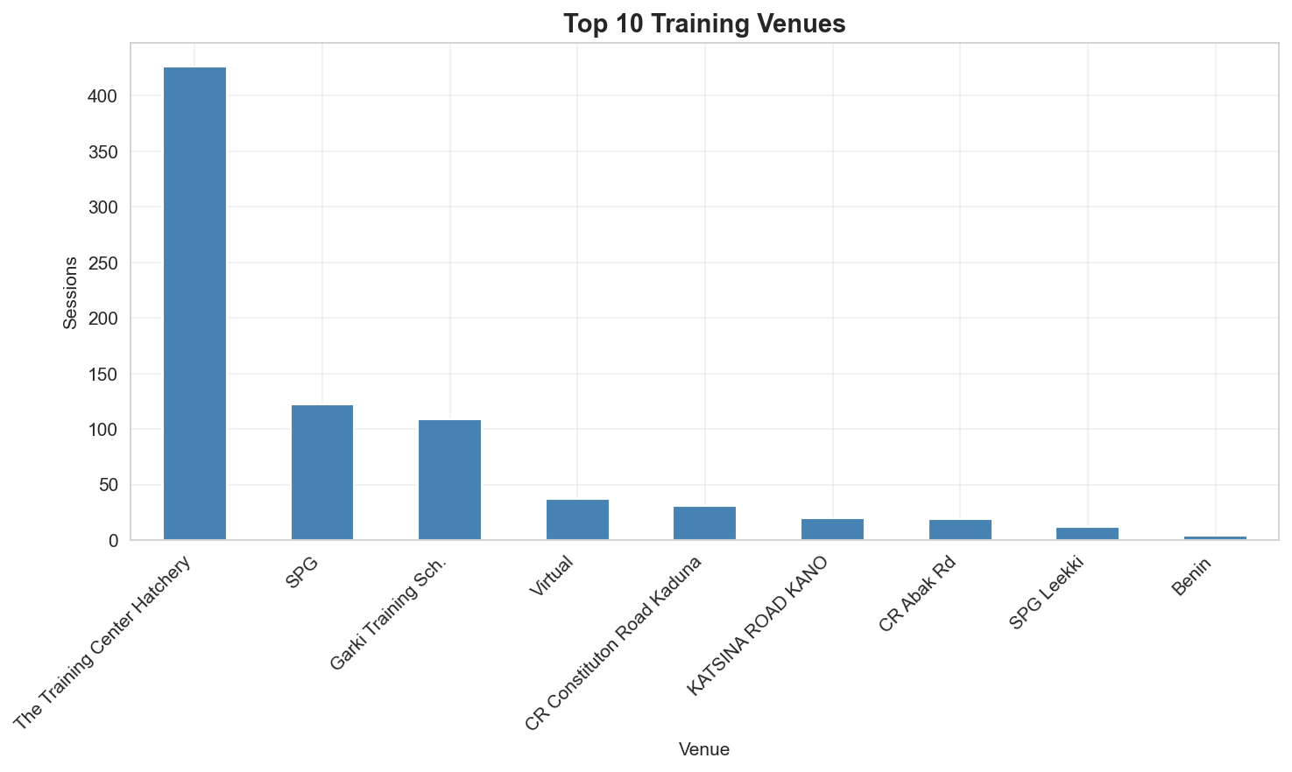
Training by Venue

Slide 9
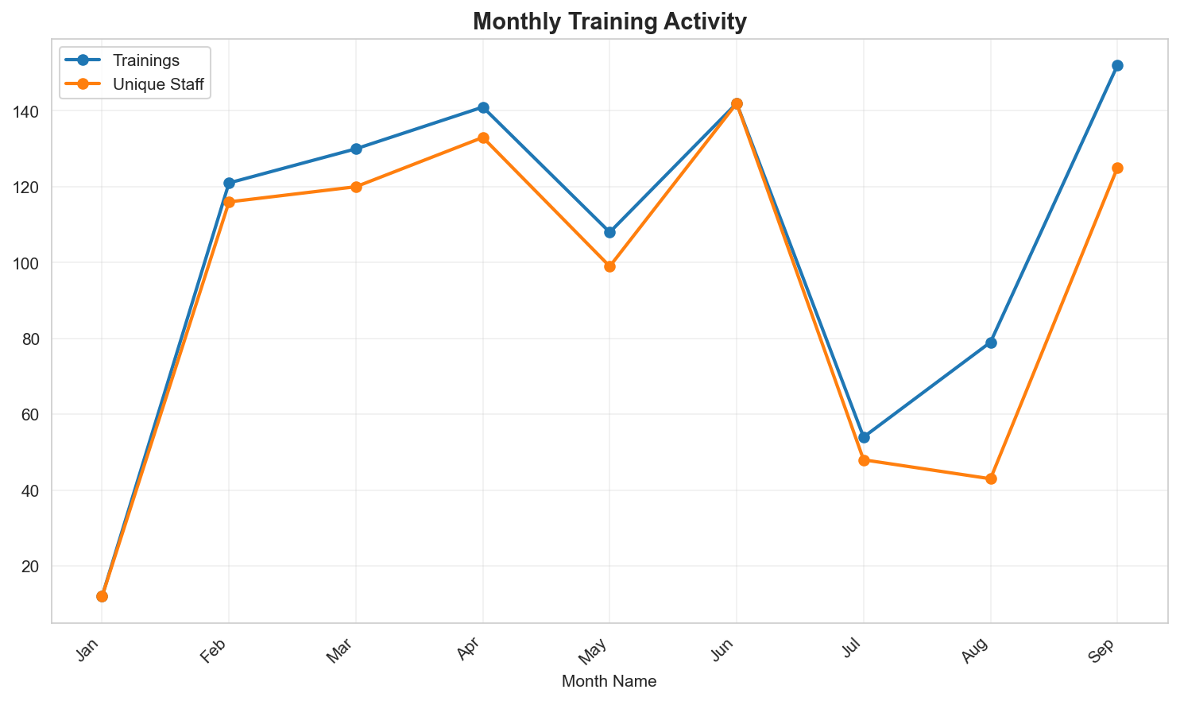
Monthly Training Trends (2025)

Slide 10
Staff Yet to be Trained
Total Staff Needing Training: 5826
These staff members are missing required trainings and are not on probation.
Top Departments:
  • OPERATIONS: 5150 staff
  • nan: 336 staff
  • SCD Operations: 115 staff
  • Human Resources: 87 staff
  • Quality & Assurance: 48 staff

